Slide 1
Pathology of Skin Disorders

Slide 2
Outlines
Introduction
Inflammatory dermatoses
Blistering dermatoses
Epithelial tumors
Disorders of pigmentation and melanocytes
Infectious disorders

Slide 3
INTRODUCTION : Skin:-
Functions as a barrier against environmental insults and fluid loss.
Composed of an epidermis and dermis.
Epidermis is comprised of keratinocytes and has four layers.
1. Stratum basalis - regenerative (stem cell) layer.
2. Stratum spinosum - characterized by desmosomes between keratinocytes.
3. Stratum granulosum - characterized by granules in keratinocytes.
4. Stratum corneum - characterized by keratin in anucleate cells.

Slide 4
Dermis:
Consists of connective tissue, nerve endings, blood and lymphatic vessels,
and adnexal structures (e.g., hair shafts,sweat glands, and sebaceous glands).

Slide 5
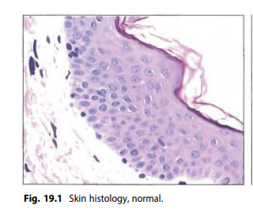

Slide 6
A. INFLAMMATORY DERMATOSES
ATOPIC (ECZEMATOUS) DERMATITIS
Pruritic, erythematous, oozing rash with vesicles and edema; often involves the face and flexor surfaces.
Type I hypersensitivity reaction; associated with asthma and allergic rhinitis.

Slide 7
CONTACT DERMATITIS
Pruritic, erythematous, oozing rash with vesicles and edema.
Arises upon exposure to allergens such as
-Poison ivy and nickel jewelry (type IV hypersensitivity).
-Irritant chemicals (e.g., detergents).
-Drugs (e.g., penicillin).
Treatment involves removal of the offending agent and topical glucocorticoids, if needed.

Slide 8
ACNE VULGARIS
Comedones (whiteheads and blackheads), pustules (pimples), and nodules; extremely common, especially in adolescents.
Due to chronic inflammation of hair follicles and associated sebaceous glands.
1. Hormone-associated increase in sebum production (sebaceous
glands have androgen receptors) and excess keratin production
block follicles, forming comedones.
2. Propionibacterium acnes infection produces lipases that break down
sebum, releasing proinflammatory fatty acids; results in pustule or
nodule formation.

Slide 9
PSORIASIS
Well-circumscribed, salmon-colored plaques with silvery scale, usually on extensor surfaces and the scalp.
Pitting of nails may also be present.
Due to excessive keratinocyte proliferation.
Possible autoimmune etiology
Associated with HLA-C.
Lesions often arise in areas of trauma (environmental trigger).

Slide 10
Histology: shows
Acanthosis (epidermal hyperplasia).
Parakeratosis (hyperkeratosis with retention of keratinocyte nuclei in
the stratum corneum).
Collections of neutrophils in the stratum corneum (Munro microabscesses).
Thinning of the epidermis above elongated dermal papillae; results
in bleeding when scale is picked off (Auspitz sign).
Treatment involves corticosteroids, UV light with psoralen, or immune-modulating therapy.

Slide 11
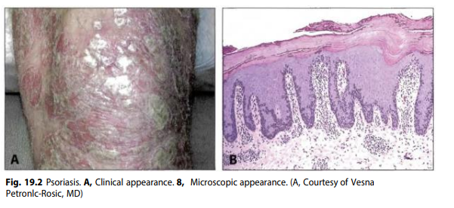

Slide 12
B. BLISTERING DERMATOSES
PEMPHIGUS VULGARIS
Autoimmune destruction of desmosomes between keratinocytes.
Due to IgG antibody against desmoglein (type II hypersensitivity.)
Presents as skin and oral mucosa bullae.
Acantholysis (separation) of stratum spinosum keratinocytes (normally
connected by desmosomes) results in suprabasal blisters.
Basal layer cells remain attached to basement membrane via
hemidesmosomes ('tombstone' appearance).
Thin-walled bullae rupture easily (Nikolsky sign), leading to shallow
erosions with dried crust.
Immunofluorescence highlights IgG surrounding keratinocytes in a 'fish
net' pattern.

Slide 13
BULLOUS PEMPHIGOID
Autoimmune destruction of hemidesmosomes between basal cells and the underlying basement membrane.
Due to IgG antibody against hemidesmosome components of the basement membrane.
Presents as blisters of the skin , usually in the elderly; oral mucosa is spared.
1. Basal cell layer is detached from the basement membrane.
2. Tense bullae do not rupture easily; clinically milder than pemphigus
vulgaris.

Slide 14
DERMATITIS HERPETIFORMIS
Autoimmune deposition of IgA at the tips of dermal papillae.
Presents as pruritic vesicles and bullae that are grouped.
Strong association with celiac disease; resolves with gluten-free diet.

Slide 15
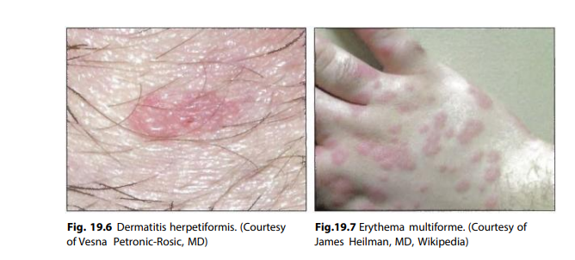

Slide 16
ERYTHEMA MULTIFORME (EM)
Hypersensitivity reaction characterized by targetoid rash and bullae.
Targetoid appearance is due to central epidermal necrosis surrounded by erythema.
Most commonly associated with HSV infection; other associations include Mycoplasma infection, drugs (penicillin and sulfonamides), autoimmune disease (e.g., SLE), and malignancy. C.
EM with oral mucosa/lip involvement and fever is termed Stevens-Johnson syndrome (SJS).
Toxic epidermal necrolysis is a severe form of SJS characterized by diffuse sloughing of skin, resembling a large burn; most often due to an adverse drug reaction.

Slide 17
EPITHELIAL TUMORS
BASAL CELL CARCINOMA
Malignant proliferation of the basal cells of the epidermis.
Most common cutaneous malignancy.
Risk factors stem from UVB-induced DNA damage and include prolonged exposure to sunlight, albinism, and xeroderma pigmentosum.
Presents as an elevated nodule with a central, ulcerated crater surrounded by dilated (telangiectatic) vessels,'pink, pearl-like papule’.
Classic location is the upper lip.
Histology shows nodules of basal cells with peripheral palisading.

Slide 18
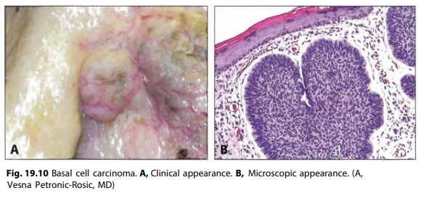

Slide 19
SQUAMOUS CELL CARCINOMA
Malignant proliferation of squamous cells characterized by formation of keratin pearls.
Risk factors stem from UVB-induced DNA damage and include prolonged exposure to sunlight, albinism, and xeroderma pigmentosum.
Additional risk factors include immunosuppressive therapy, arsenic exposure, and chronic inflammation (e.g., scar from burn or draining sinus tract).
Presents as an ulcerated, nodular mass, usually on the face (classically involving the lower lip).

Slide 20
Actinic keratosis is a precursor lesion of squamous cell carcinoma and presents as a hyperkeratotic, scaly plaque, often on the face, back, or neck.
Keratoacanthoma is well-differentiated squamous cell carcinoma that develops rapidly and regresses spontaneously; presents as a cup-shaped tumor filled with keratin debris.

Slide 21
D. DISORDERS OF PIGMENTATION AND MELANOCYTES
BASIC PRINCIPLES
Melanocytes are responsible for skin pigmentation and are present in the basal layer of the epidermis.
Derived from the neural crest.
Synthesize melanin in melanosomes using tyrosine as a precursor molecule.
Pass melanosomes to keratinocytes.

Slide 22
VITILIGO
Localized loss of skin pigmentation.
Due to autoimmune destruction of melanocytes.
ALBINISM
Congenital lack of pigmentation.
Due to an enzyme defect (usually tyrosinase) that impairs melanin production.
May involve the eyes (ocular form) or both the eyes and skin (oculocutaneous form).
Increased risk of squamous cell carcinoma, basal cell carcinoma, and melanoma due to reduced protection against UVB.

Slide 23
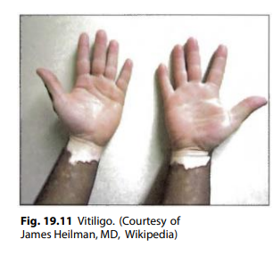

Slide 24
NEVUS (MOLE)
Benign neoplasm of melanocytes.
Congenital nevus is present at birth; often associated with hair.
Acquired nevus arises later in life.
Begins as nests of melanocytes at the dermal-epidermal junction (junctional nevus); most common mole in children.
Grows by extension into the dermis (compound nevus).
Junctional component is eventually lost resulting in an intradermal nevus, which is the most common mole in adults.

Slide 25
Characterized by a flat macule or raised papule with symmetry, sharp borders, evenly distributed color, and small diameter(< 6 mm).
Dysplasia may arise (dysplastic nevus), which is a precursor to melanoma.

Slide 26
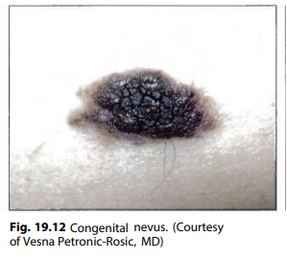

Slide 27
MELANOMA
Malignant neoplasm of melanocytes; most common cause of death from skin cancer.
Risk factors are based on DVB-induced DNA damage and include prolonged exposure to sunlight, albinism, and xeroderma pigmentosum; an additional risk factor is dysplastic nevus syndrome (autosomal dominant disorder characterized by formation of dysplastic nevi that may progress to melanoma).
Presents as a mole-like growth with "ABCD"

Slide 28
1. Asymmetry
2. Borders are irregular.
3. Color is not uniform.
4. Diameter > 6 mm
Characterized by two growth phases
1. Radial growth horizontally along the epidermis and superficial
dermis; low risk of metastasis
2. Vertical growth into the deep dermis i. Increased risk of metastasis;
depth of extension (Breslow thickness) is the most important
prognostic factor in predicting metastasis

Slide 29
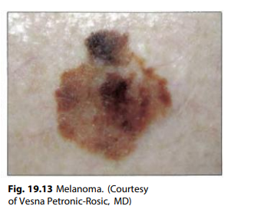

Slide 30
Variants include
1. Superficial spreading - most common subtype; dominant early radial growth results in good prognosis.
2. Lentigo maligna melanoma - lentiginous proliferation (radial growth);
good prognosis
3. Nodular - early vertical growth; poor prognosis
4. Acral lentiginous - arises on the palms or soles, often in dark-skinned
individuals; not related to UV light exposure

Slide 31
E. INFECTIOUS DISORDERS
IMPETIGO
Superficial bacterial skin infection, most often due to S aureus or S pyogenes
Commonly affects children
Presents as erythematous macules that progress to pustules, usually on the face; rupture of pustules results in erosions and dry, crusted, honey-colored serum

Slide 32
CELLULITIS
Deeper (dermal and subcutaneous) infection, usually due to S aureus or S pyogenes
Presents as a red, tender, swollen rash with fever
Risk factors include recent surgery, trauma, or insect bite.
Can progress to necrotizing fasciitis with necrosis of subcutaneous tissues due to infection with anaerobic 'flesh-eating' bacteria

Slide 33
STAPHYLOCOCCAL SCALDED SKIN SYNDROME
Sloughing of skin with erythematous rash and fever; leads to significant skin loss
Due to S aureus infection; exfoliative A and B toxins result in epidermolysis of the stratum granulosum.
Distinguished histologically from toxic epidermal necrolysis by level of skin separation; separation in TEN occurs at the dermal-epidermal junction.

Slide 34
VERRUCA (WART)
Flesh-colored papules with a rough surface
Due to HPV infection of keratinocytes; characterized by koilocytic change
Hands and feet are common locations.

Slide 35
MOLLUSCUM CONTAGIOSUM
Firm, pink, umbilicated papules due to poxvirus; affected keratinocytes show cytoplasmic inclusions (molluscum bodies)
Most often arise in children; also occur in sexually active adults and immunocompromised individuals

Slide 36
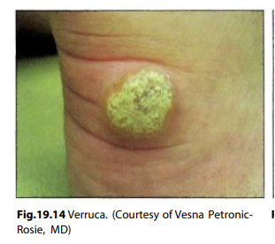

Slide 37
References
Robbins and cotrans pathologic basics of disease 10th edition

Slide 38
Thank you!

